Slide 1


Unlocking Growth: Strategies for Reducing Subscription Churn
In today's competitive landscape, understanding and mitigating customer churn is paramount for the sustainable growth of any subscription-based business. This presentation will explore a data-driven approach to identifying churn drivers and implementing effective retention strategies.

Slide 2
The Silent Threat: Understanding Churn
Ever subscribed to a service, only to cancel it shortly after?
That's churn. And it's costing businesses billions.
Churn refers to the rate at which customers discontinue their subscriptions to a service. It's a critical metric that directly impacts revenue, profitability, and long-term business viability.

Slide 3



The Gravity of the Problem: Our Churn Challenge
Our current monthly churn rate stands at a concerning 15%, significantly higher than the industry average of 5%. This disparity highlights an urgent need for intervention.
High churn doesn't just mean lost subscriptions; it translates to a higher Customer Acquisition Cost (CAC) and erodes Lifetime Value (LTV), directly impacting our bottom line and hindering potential growth.

Slide 4
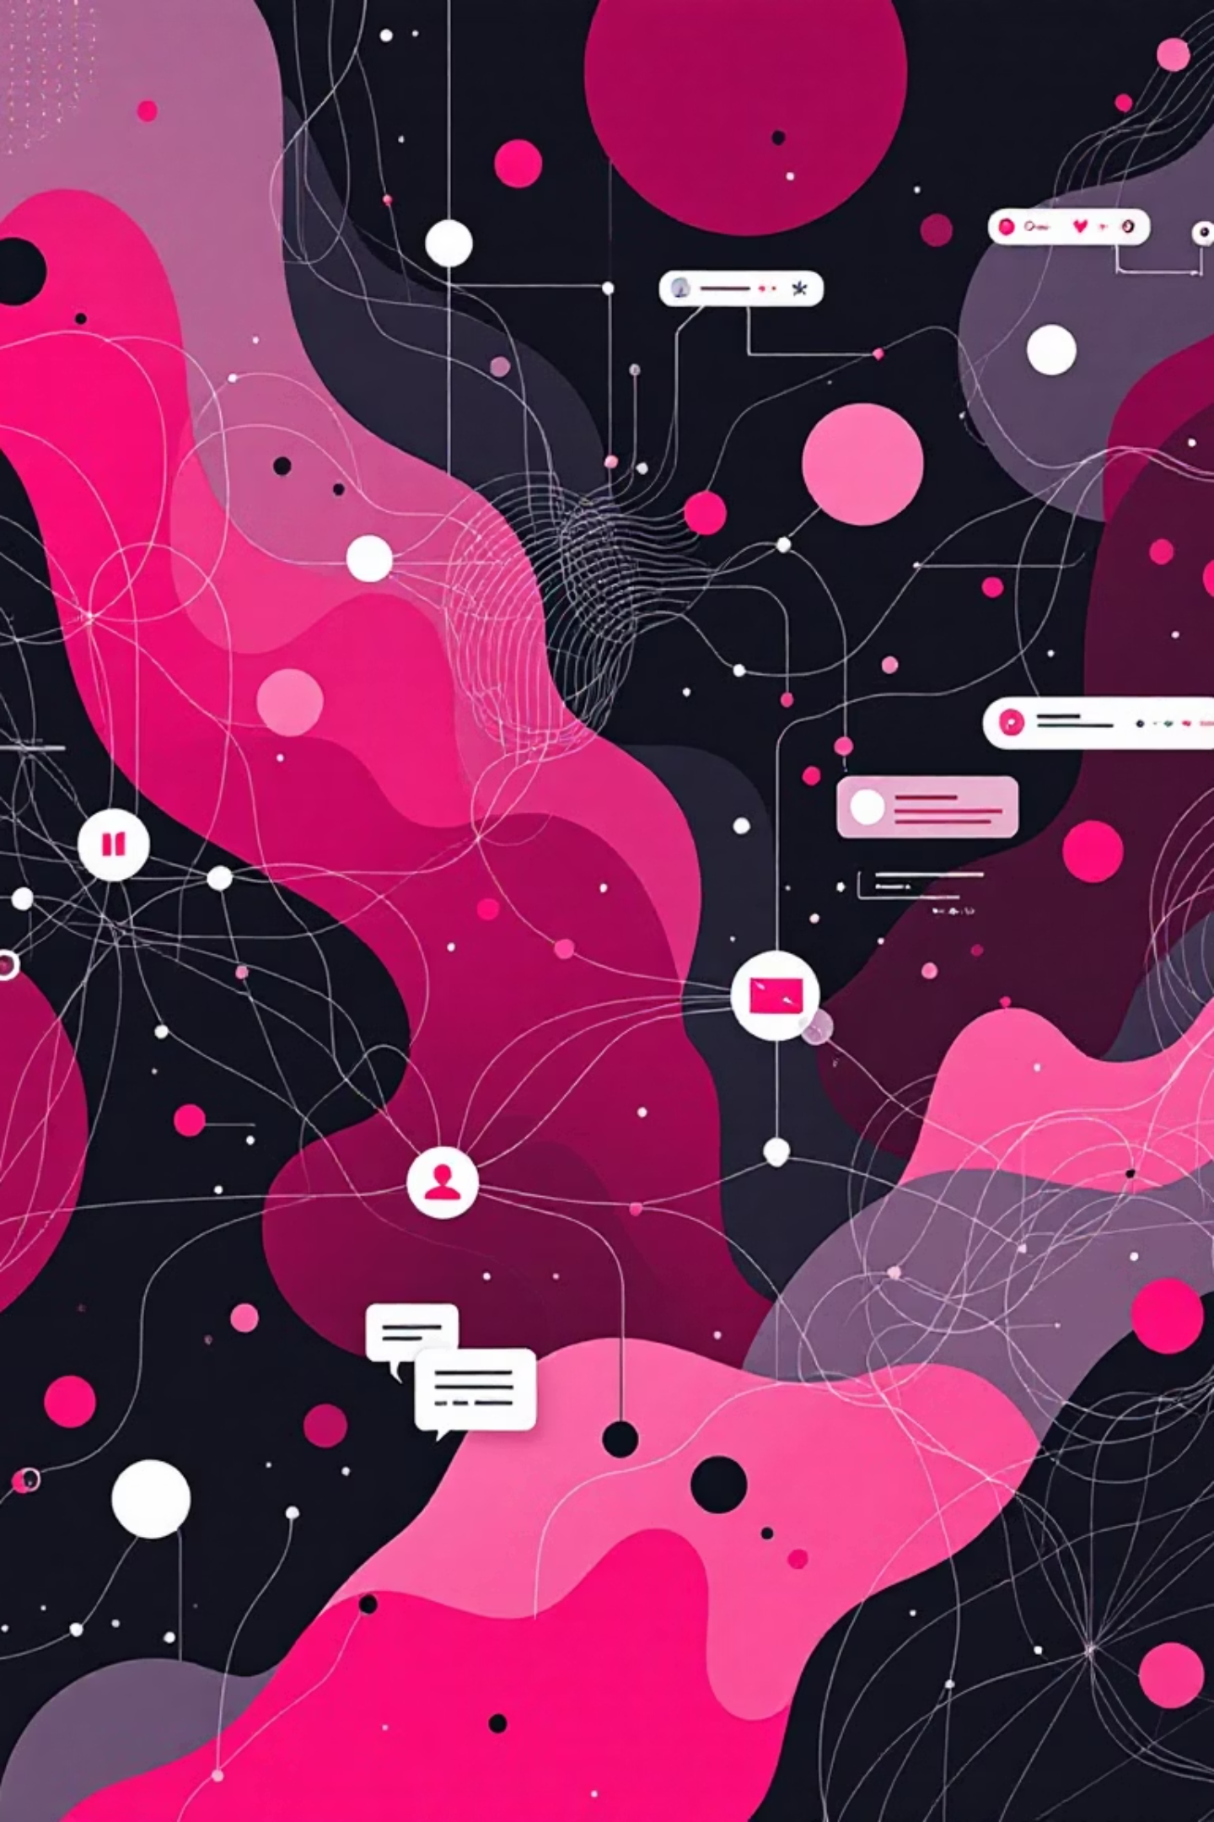
Unlocking Insights: Our Data Arsenal
To combat churn effectively, we leverage a rich dataset providing a 360-degree view of our customers:
Customer Profile: Demographic insights (age, gender, location) to segment our audience.
Usage Patterns: Detailed records of platform engagement (hours/week, devices used) reveal behavioral trends.
Engagement Metrics: Last login activity and content completion rates to gauge active participation.
Feedback Loop: Satisfaction scores and direct cancellation reasons from surveys provide invaluable qualitative data.

Slide 5
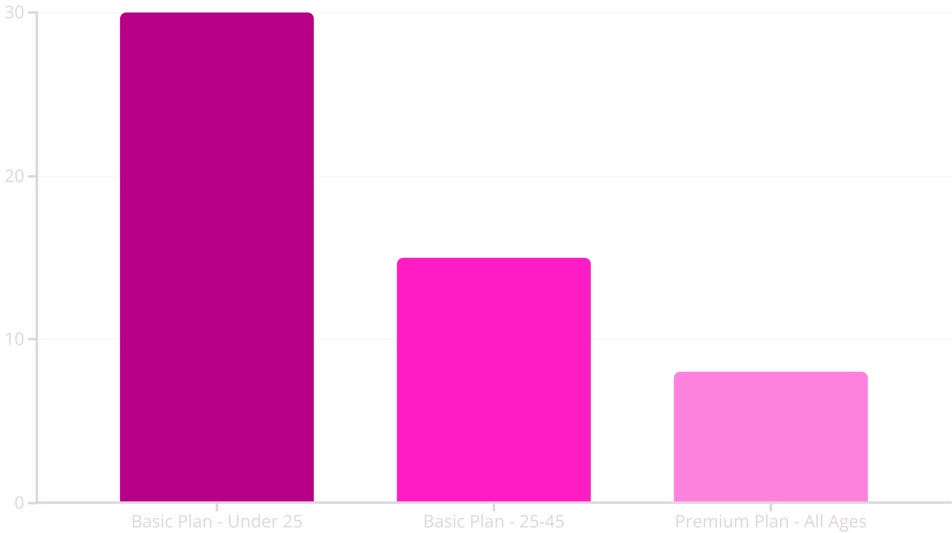
Analysis Step 1: Descriptive Deep Dive
Our initial descriptive analysis focused on identifying high-churn segments.
Key Finding: Users on the Basic plan under 25 years old exhibit twice the churn rate compared to other segments. This suggests potential issues with pricing, content relevance, or perceived value for this specific demographic.

Slide 6
Analysis Step 2: Diagnostic Insights
Moving beyond description, our diagnostic analysis aimed to uncover the causal factors behind churn, specifically correlating usage patterns with cancellation rates.
80%
Higher Likelihood of Churn
Users who engage with our platform for less than 3 hours per week are 80% more likely to churn than those with higher engagement.
This strong correlation highlights that low engagement is a significant precursor to churn, regardless of plan type or demographic. It indicates a need to drive deeper, more frequent interaction with the service.

Slide 7
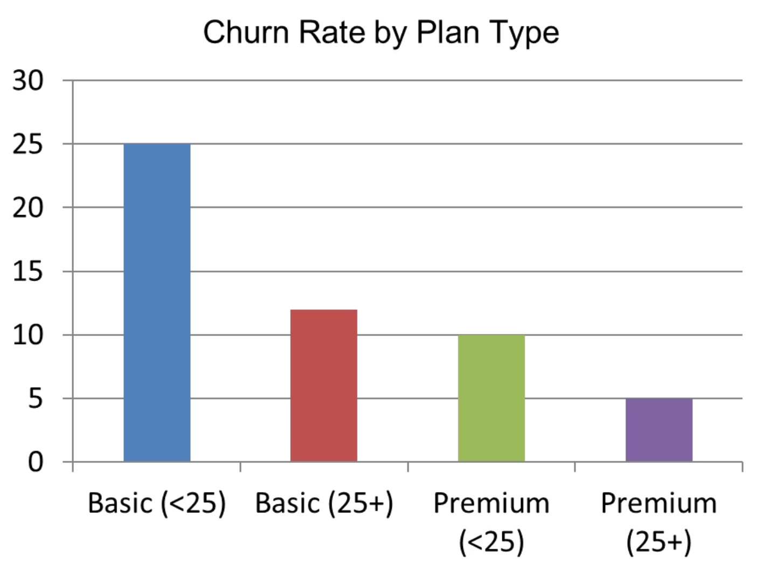
Understanding Churn by Plan Type and Age Group
A deeper examination of our customer data reveals significant variations in churn rates across different plan types and age demographics. This segmentation is crucial for pinpointing specific pain points and tailoring retention efforts.
Our analysis indicates that customers on the Basic Plan, particularly those under 25 years old, exhibit a notably higher churn rate. This suggests a potential misalignment between the perceived value of the basic offering and the expectations of our younger audience.
Conversely, users on premium plans and those in older age groups demonstrate higher loyalty, underscoring the importance of understanding the unique needs and value propositions for each segment.

Slide 8
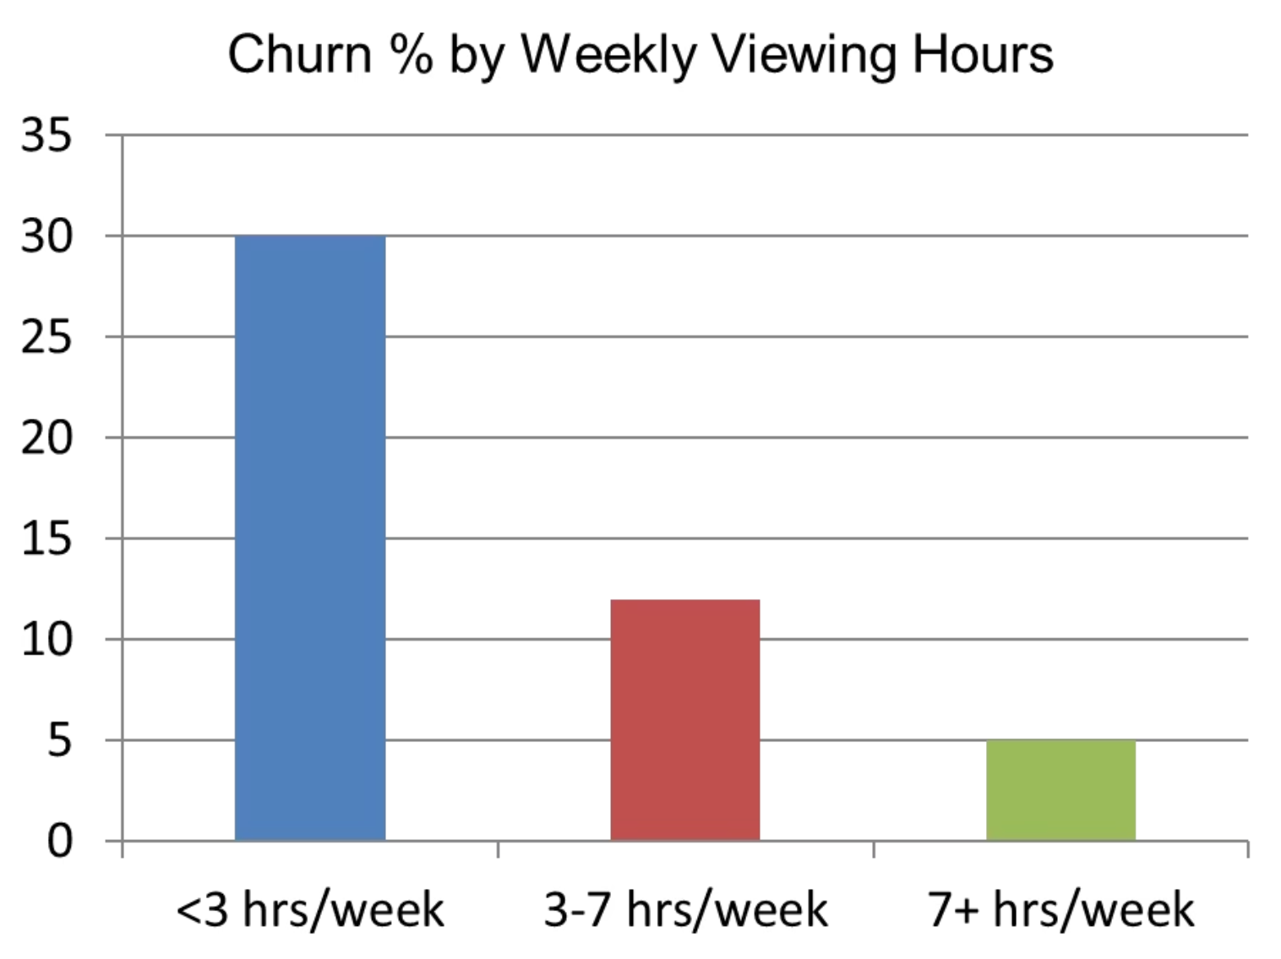
Engagement vs Churn
Our analysis clearly demonstrates a strong inverse relationship between user engagement and churn rates. Customers who actively interact with our platform for longer durations and more frequently are significantly less likely to discontinue their subscriptions.
Specifically, users engaging for less than 3 hours per week exhibit an 80% higher likelihood of churning compared to more engaged users. This highlights engagement as a critical leading indicator of retention, underscoring the importance of fostering deeper and more consistent

Slide 9


Key Insights: Unpacking Churn Drivers
Synthesizing our descriptive and diagnostic findings reveals three core drivers of churn:
Low Engagement
Price Sensitivity
Content Irrelevance
Infrequent usage is a primary indicator of dissatisfaction and precursor to cancellation.
Basic plan users, especially younger demographics, perceive less value for money.
Lack of tailored or engaging content for younger audiences impacts their retention.

Slide 10



Actionable Strategies: Driving Retention
Based on our insights, we propose targeted recommendations:
Personalized Content
Targeted Email Campaigns
Flexible Discounting
Implement AI-driven content recommendations to increase relevance and drive engagement for all users.
Introduce dynamic discounts or tiered pricing for Basic plan users, especially the younger segment, to address price sensitivity.
Automate re-engagement emails for low-activity users, offering curated content or incentives.

Slide 11
Tangible Impact: Our Success Story
Implementing these strategies yielded significant positive outcomes within just three months:
15% → 8%
25%
Churn Reduction
CLV Increase
Our monthly churn rate decreased from 15% to a remarkable 8%, significantly exceeding expectations.
Customer Lifetime Value surged by 25%, reflecting stronger, more enduring customer relationships.
This success demonstrates that data-driven retention strategies not only save valuable customers but also optimize marketing spend by focusing on nurturing existing relationships over costly acquisition.

Slide 12
Transformative Impact: Our Data-Driven Success
Our strategic interventions, guided by comprehensive data analysis, yielded significant improvements in key metrics:
Before: Monthly churn rate stood at 15%.
After: Monthly churn rate was reduced to a remarkable 8%.
Customer Lifetime Value (CLV) increased by 25%.
Retention costs were significantly reduced.
"That’s not magic — that’s data."

Slide 13

The Power of Business Analysis
"Business analysis turns raw data into actionable insights, driving strategic decisions and sustainable growth."
We've seen how understanding churn, backed by robust data analysis, can transform business outcomes. It's about listening to your data and responding with targeted, effective solutions.
Let's Discuss:
What's the last subscription you cancelled and why? Share your insights.

